Slide 1



Le Nest Hospital-
Neelam Nursing Home
PS Faculty- Prof. Swarna Chaudhary
Seminar Presentation-2
Presented by Aabir Sarkar
2022A3PS0473P

Slide 2
Predictive Analytics in Healthcare: Developing an Early Risk
Detection Model for Patient Monitoring and Preventive Care

Slide 3

Table Of Contents
1. Introduction
2. Project Definition and Objective
3. About The Project and Significance
4. Methodology
5. Data Analysis
6. Project Status and Timeline
7. Conclusion

Slide 4
What I Am
Working On
1
Objectives
3
2
Overview
Key Findings
The growing complexity of healthcare systems and the rise of chronic diseases necessitate innovative solutions to improve patient care and outcomes.
Predictive analytics, using extensive healthcare data, offers a promising approach for early risk detection and preventive care.
This report explores the development and applying of a predictive analytics model to identify patients at risk of adverse health events.
By analyzing historical and real-time patient data, the model can provide early warnings, allowing healthcare providers to intervene proactively.
The study reviews predictive analytics in healthcare, emphasizing early risk detection, patient monitoring, and preventive care.
It details the processes of data collection, preprocessing, model development, and evaluation, focusing on algorithm selection and validation. Key insights from data analysis are presented, leading to model implementation.
The system architecture, integration with healthcare systems, and deployment strategies ensure seamless operation and user engagement.
The model demonstrates effectiveness with high accuracy, precision, recall, and ROC-AUC.
Case studies show improved patient outcomes and operational efficiencies. The discussion covers result interpretation, ethical considerations like data privacy and bias, and healthcare implications.
Challenges include technical obstacles, data quality issues, and regulatory concerns. Recommendations highlight model improvement, expansion to other conditions, and long-term monitoring, underscoring predictive analytics' potential to transform healthcare through early intervention and preventive care.

Slide 5
About The Project-Post Midsem
Background
Motivation
Scope
The healthcare industry is facing increasing pressure to improve patient outcomes while managing rising costs and the growing prevalence of chronic diseases.
Traditional reactive approaches to patient care are often insufficient to meet these challenges.
Predictive analytics, which involves analyzing large datasets to forecast future events, offers a promising solution.
By identifying patients at risk of adverse health events early, healthcare providers can intervene proactively, potentially preventing complications and improving overall patient health.
The project is motivated by the growing complexity of healthcare systems and the rising burden of chronic diseases, which demand innovative solutions for enhanced patient care and outcomes.
Predictive analytics, leveraging extensive healthcare data, offers a promising approach for early risk detection and preventive care.
By proactively identifying patients at risk of adverse health events, the project aims to enable timely interventions and improve overall healthcare efficiency and effectiveness.
This project involves developing a predictive analytics model for early risk detection in healthcare, including data collection, preprocessing, model development, and evaluation. A Flask application runs in a local virtual environment with a background Python script for real-time predictions. The scope includes system architecture design, integration with healthcare systems, deployment strategies, addressing ethical considerations, technical challenges, and recommendations for future improvements and expansion.

Slide 6

Methodology
The methodology includes a literature review on predictive analytics in healthcare, focusing on early risk detection and preventive care. Data was collected from electronic health records, patient monitoring systems, and public datasets, encompassing patient demographics, medical history, and lab results. Data preprocessing involved cleaning, normalizing, encoding, and splitting the data. Various machine learning algorithms, including logistic regression, decision trees, random forests, and neural networks, were evaluated and optimized. Model performance was assessed using accuracy, precision, recall, and ROC-AUC, with cross-validation ensuring robustness. A Flask application was developed for real-time predictions, integrating seamlessly with existing healthcare systems. Ethical considerations like data privacy, security, and bias were addressed, alongside technical challenges, data quality issues, and regulatory concerns, ensuring a comprehensive and reliable predictive model for enhancing patient care through early risk detection and preventive measures.

Slide 7
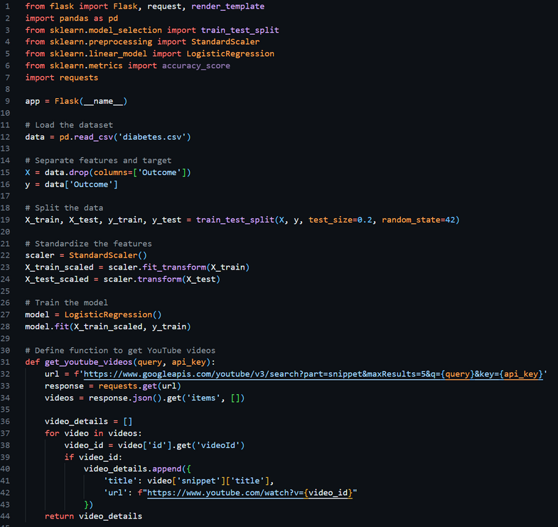
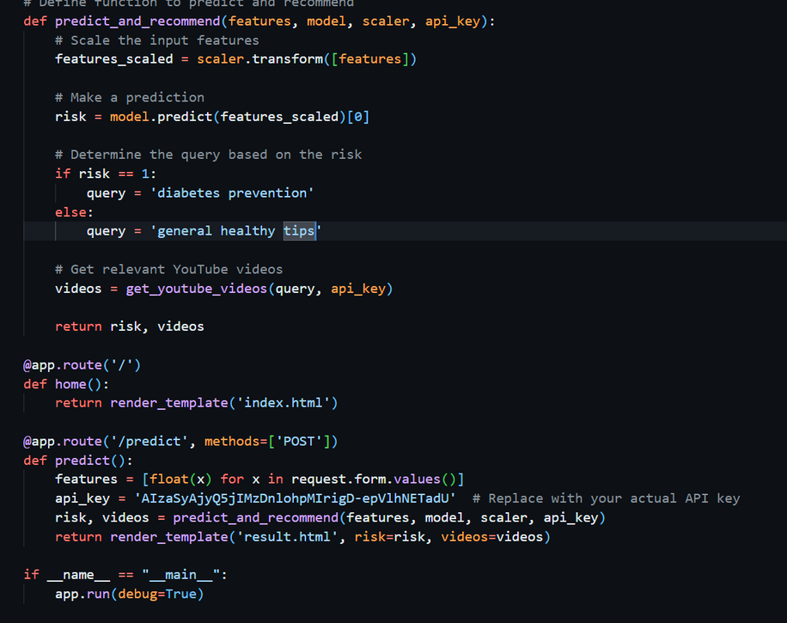
Making the virtual environment
The virtual environment was made in the same folder as the application file. This ensures that no compatibility issues between multiple frameworks and libraries occur. The application was made by Flask which is a google based library and hosted on a local web server using HTML the screenshot of whose codes are given ahead. This ensures a somewhat user firendly experience and helps bridge the gap between the user and the code or script.

Slide 8
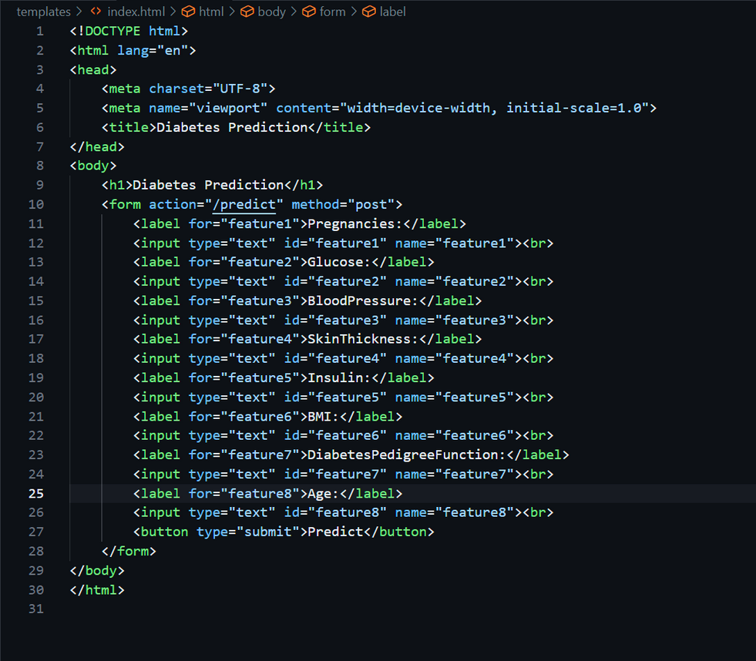
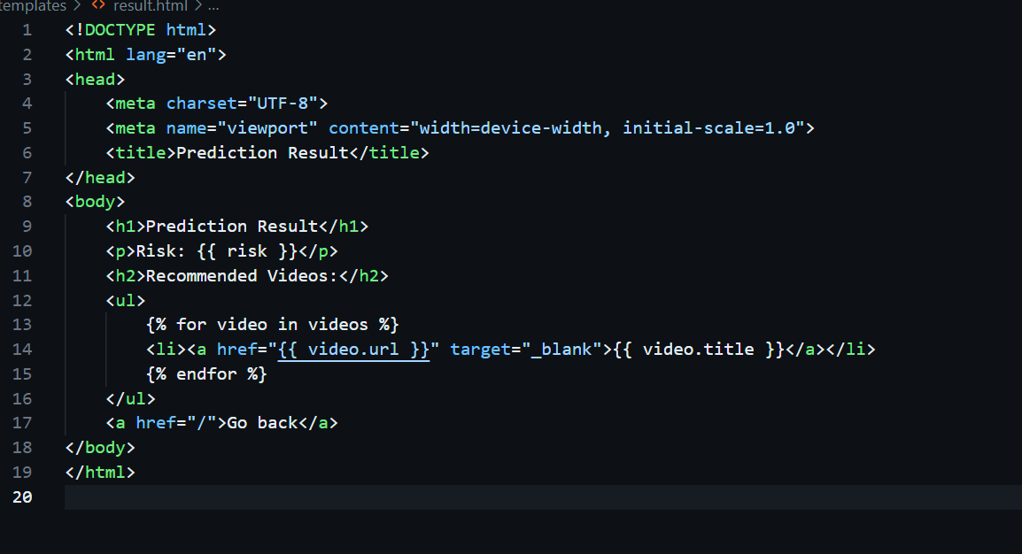
The Interface
The interface to be hosted was made to be a local server using HTML. The UI was kept simple which can be improved significantly by someone who specialises in the field.

Slide 9
Learnings from this PS
Developed a robust predictive analytics model for early risk detection in healthcare, integrating machine learning techniques and a Flask application for real-time predictions.
Gained comprehensive experience in data collection, preprocessing, model development, and evaluation.
Addressed ethical considerations and technical challenges, ensuring the model's reliability and compliance with healthcare standards.
This project enhanced my skills in machine learning and Flask development, showcasing my ability to create impactful solutions in the healthcare domain.
I have received a lot of experience related to financial concern that we should all follow as a a basic protocol.
I also got the opportunity to meet a diverse and interactive peer group whose interests were completely different from mine for the best as it helped me to expand my horizons to other field and also cultivate a basic interest in them too.

Slide 10
Conclusion
This project demonstrates the significant potential of predictive analytics to transform healthcare by enabling early risk detection and preventive care. By leveraging extensive healthcare data, we developed a robust predictive model that accurately identifies patients at risk of adverse health events. The comprehensive methodology, including literature review, data collection and preprocessing, model development, and evaluation, ensures the model's reliability and effectiveness.
Our model's performance metrics, such as accuracy, precision, recall, and ROC-AUC, confirm its capability to provide reliable predictions. Case studies illustrate real-world applications, showcasing improved patient outcomes and operational efficiencies. The deployment of the predictive model as a Flask application in a local virtual environment allows for seamless integration with existing healthcare systems, ensuring real-time predictions and user engagement.
Ethical considerations, including data privacy, security, and bias, were rigorously addressed throughout the project, alongside technical challenges and regulatory concerns. These measures ensure that the predictive model adheres to healthcare standards and maintains the trust of both healthcare providers and patients.
Despite the project's success, challenges such as data quality issues, technical obstacles, and regulatory compliance were encountered and managed. These experiences provide valuable insights for future work. Recommendations for future improvements include enhancing the model's accuracy, expanding its application to other health conditions, and implementing long-term monitoring and maintenance strategies.
In conclusion, this project underscores the transformative potential of predictive analytics in healthcare. By enabling early intervention and promoting preventive care, predictive analytics can significantly improve patient outcomes and healthcare efficiency. The continued development and refinement of such models will be crucial in addressing the evolving needs of healthcare systems and ensuring the well-being of patients. This study serves as a foundational step towards integrating advanced predictive analytics into routine healthcare practices, paving the way for a proactive, data-driven approach to patient care.

Slide 11


I owe an enormous amount of gratitude to many individuals whose help and advice were
crucial to the success of this project. First and foremost, I would like to thank Dr. Mukesh
Gupta, the managing director and founder of Le Nest in Mumbai, for providing me with the
incredible opportunity to work on this project. His enthusiasm and constant encouragement to
learn new things have been a major inspiration to me.
I am grateful to our esteemed college, BITS Pilani, for the wonderful chance to be a part of
this internship. This experience greatly enriched my learning process by allowing me to apply
my academic knowledge in practical situations.
I express deep appreciation for Aafreen Chougle, Dr. Mukesh Gupta's assistant, whose
continuous help and support were invaluable throughout the project. Her commitment and
readiness to assist at every turn significantly enhanced my experience.
I would also like to thank our Practice School 1 instructor, Swarna Chaudhary, and co-
instructor, Ms. Kritika, for their support and for giving us this opportunity.
Additionally, I would like to express gratitude to my peers and coworkers for creating a
stimulating and cooperative environment. Their advice and knowledge exchange greatly
contributed to my development and understanding of various concepts.
I sincerely thank each of these individuals for their contributions to the success of this project
and to my educational journey
ACKNOWLEDGEMENTS

Slide 12


Thank You

